Slide 1






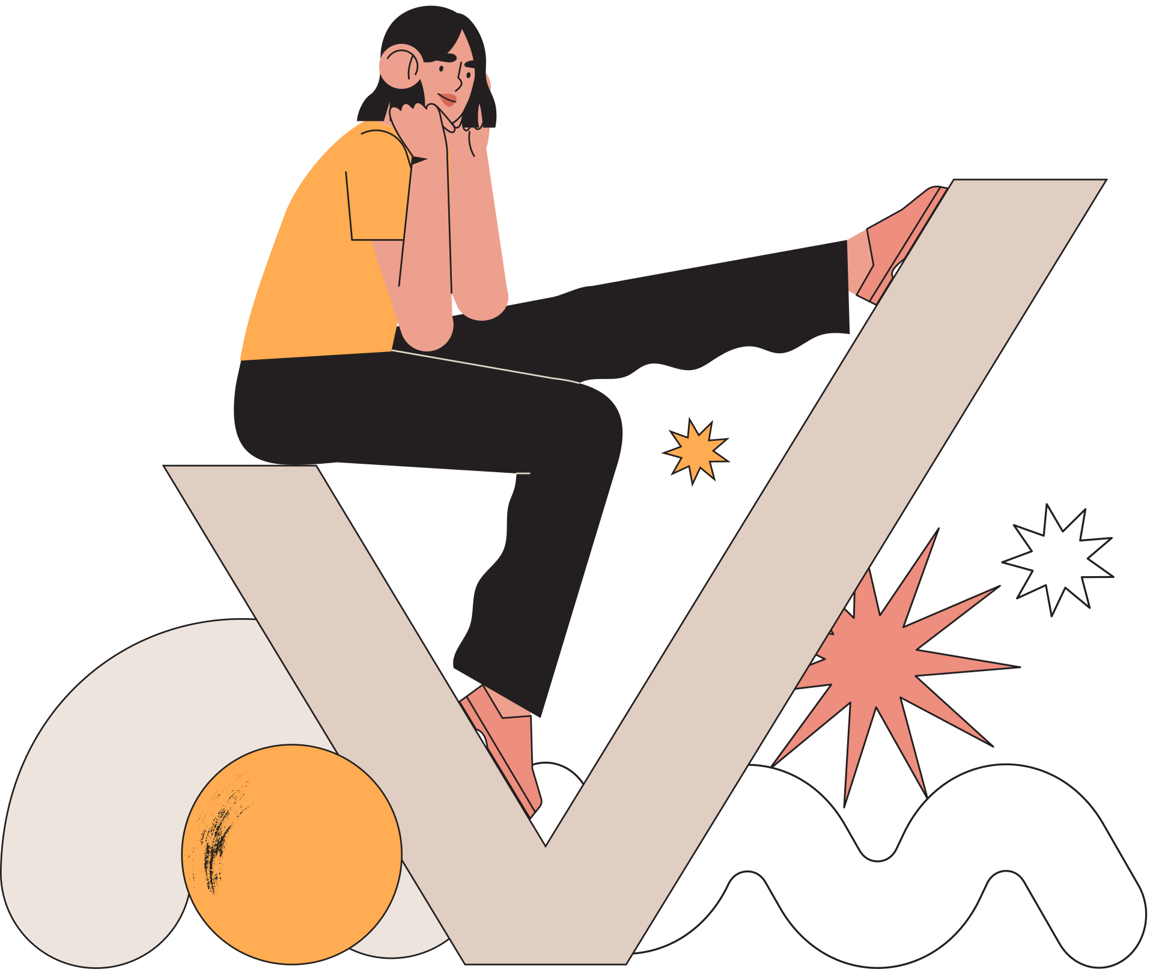
CA4 Project Presentation
A Comprehensive Survey of Deep Learning techniques for Bidirectional Image Context Mapping

Slide 2
Table of Content
Introduction
Problem Statement
It's just intro
Establishing Idealogy
Literature Survey
Our Solutions
Exploring the current works
What we did !!
Comparisons
Future Endeavor
How our models hold
What we are planning to do
Conclusion

Slide 3


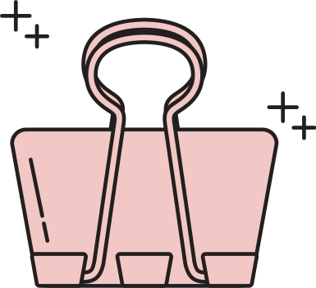



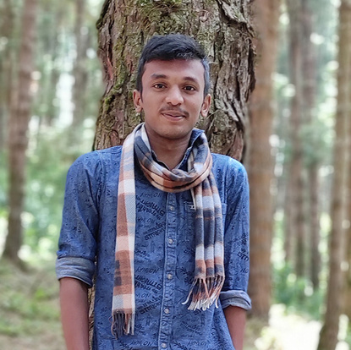
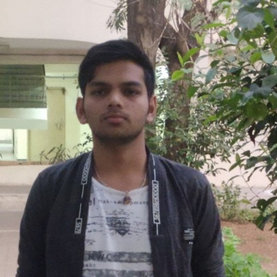
Our Team
Karan V
SathishKumar M
Vishal L
E0119039
E0119052
E0119010

Slide 4



Introduction
Image Processing
Language Processing
There are several classification, regression and generative models
There are several Text generation, Classification, Summarization and QA generation
Image Contextual Undestanding
Combining the both to enable the next gen AI to better perceive the world

Slide 5
Problem Statement
Contextual Understanding
Contextual data predictions in image video and audio have been difficult due to complexity of human language, with various phonetics and meaning of the same words producing various context
Bidirectional Retrieval
All the existing models try to perform only one way either Text to image or Image to Text

Slide 6



What We Did
VAE
Novel Model
ViT & Beam Search
VAE is a deep unsupervised generative approach for genrating latent distribution
Friendly and professional customer service specialist with extensive experience
Visual Transformers to create a unified model to create accurate context mapping

Slide 7
Literature Survey
Publication : International Journal of Applied Engineering Research - RI Publication
Title : Image Captioning - A Deep Learning Approach(2019)
Overview :
The model performs image captioning by basic encoder decoder with a image feature extraction layer by VGG 16 weights. Evaluated the algorithm using a dataset of 500 images from Flickr8k Dataset and achieves 0.683 Bleu Score
Limitations :
Test Images are very less so Bleu score is not reliable.
Computationally expensive
Attention mechanism is not added to the model
Feature extraction is only tried using VGG 16
LSTM memory units and total params of the model are very less

Slide 8
Literature Survey
Publication : IEEE Access
Title : EyeSee: Camera to Caption with Attention Mechanism(2020)
Overview :
The model performs image captioning by Show, Attend and Tell research paper model and encoder includes the pretrained CNN, InceptionNet, along with a fully connected layer which is made up of a dense layer and a ReLU layer. The decoder, it consists of two cascading elements being the attention function and the RNN(GRU cells)
Limitations :
Computationally expensive as they are proposing for a mobile app
Small Pretrained models should be used
Model is domain specific as it is trained on flickr8k and flickr30k

Slide 9
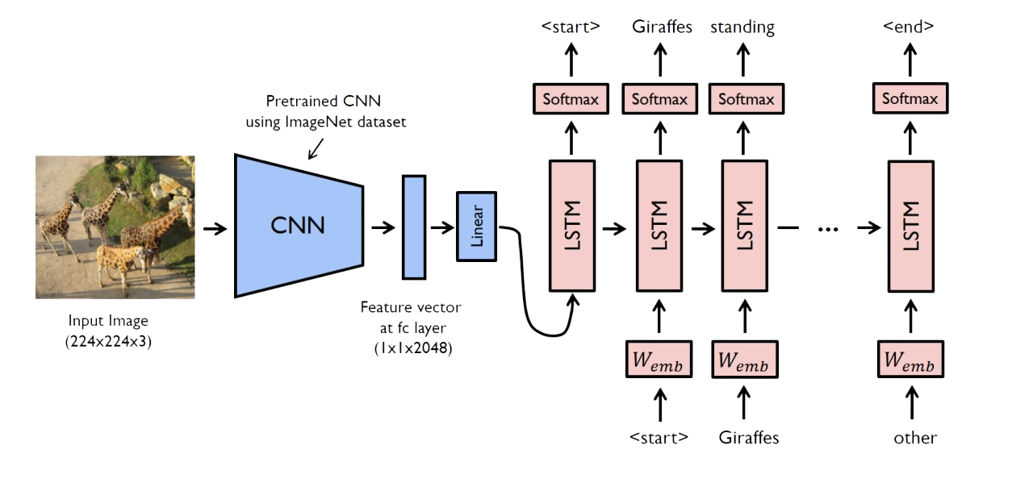
Encoder Decoder
The encoded vector aims to encapsulate the information for all input elements in order to help the decoder make accurate predictions.
Each recurrent unit accepts a hidden state from the previous unit and produces and output as well as its own hidden state

Slide 10
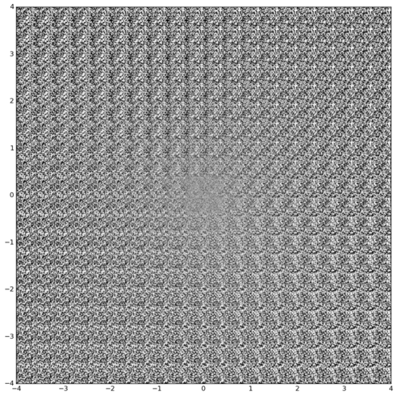
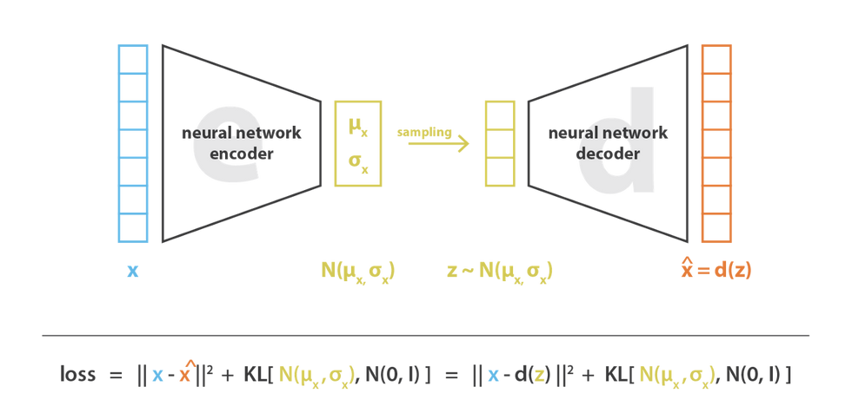
Variational Auto Encoder
The encoder downsamples the images and the bottle neck layer is responsible for sampling the latent distribution vector
The Decoder upsamples the sampled latent vector to diffrent representation of the input.

Slide 11
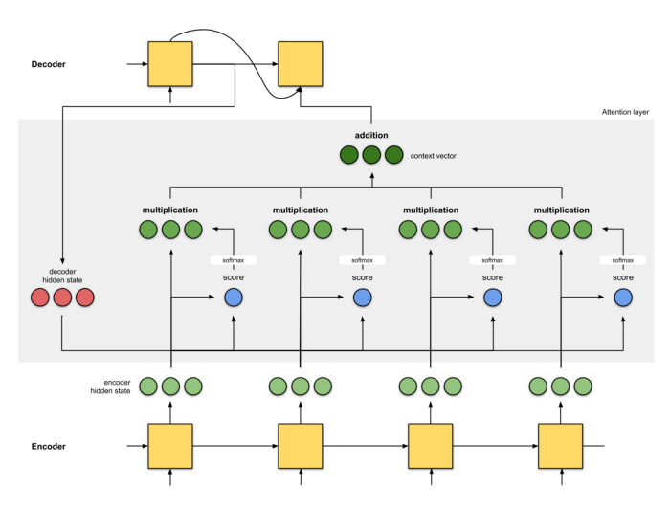
Attention-Encoder Decoder
This effect enhances some parts of the input data while diminishing other parts.
It assigns a probablity distributed weights to each part of the enocder at each time steps.

Slide 12
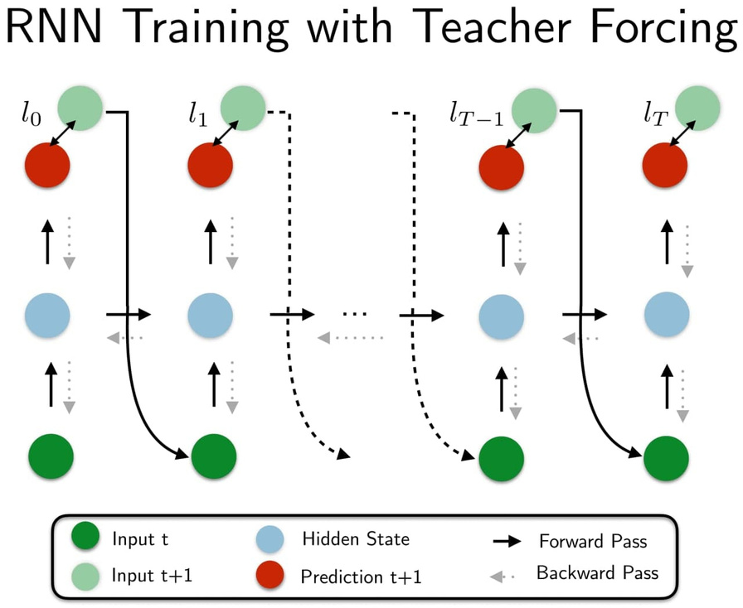
Teacher Forcing Mechanism
Teacher forcing is a strategy for training RNN that uses ground truth as input, instead of model output from a prior time step as an input. Models that have recurrent connections from their outputs leading back into the model may be trained with teacher forcing.

Slide 13
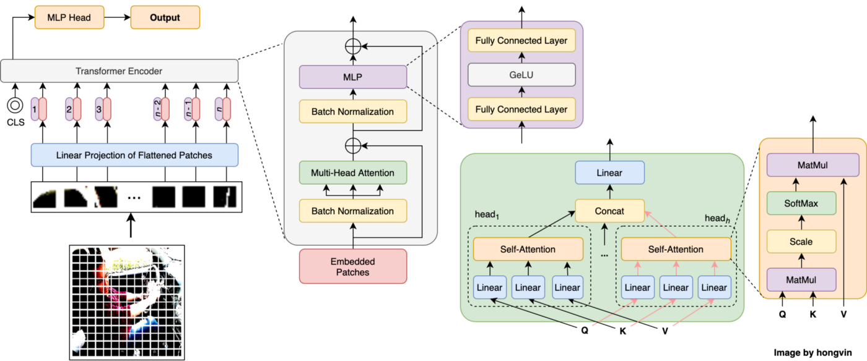
Vision Transformers
Overview
The Vision Transformer, or ViT, is a model for image classification that employs a Transformer-like architecture over patches of the image. An image is split into fixed-size patches, each of them are then linearly embedded, position embeddings are added, and the resulting sequence of vectors is fed to a standard Transformer encoder.

Slide 14

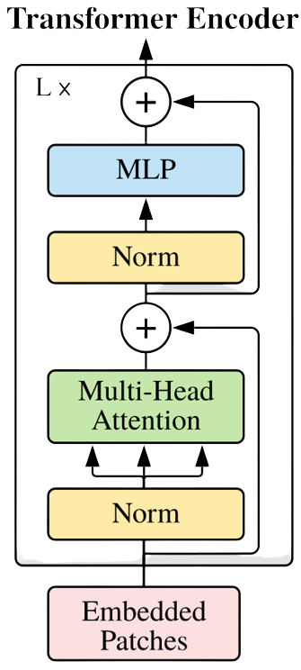

Slide 15

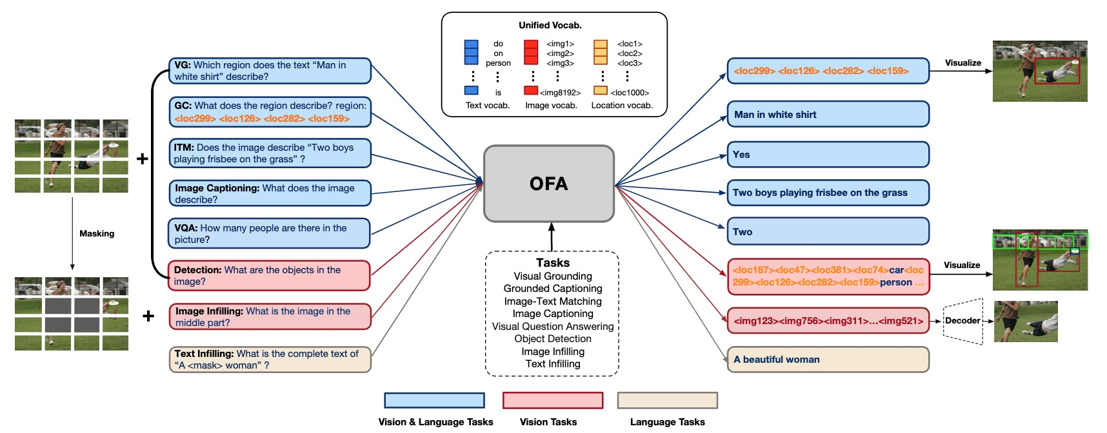
OFA-Variation

Slide 16
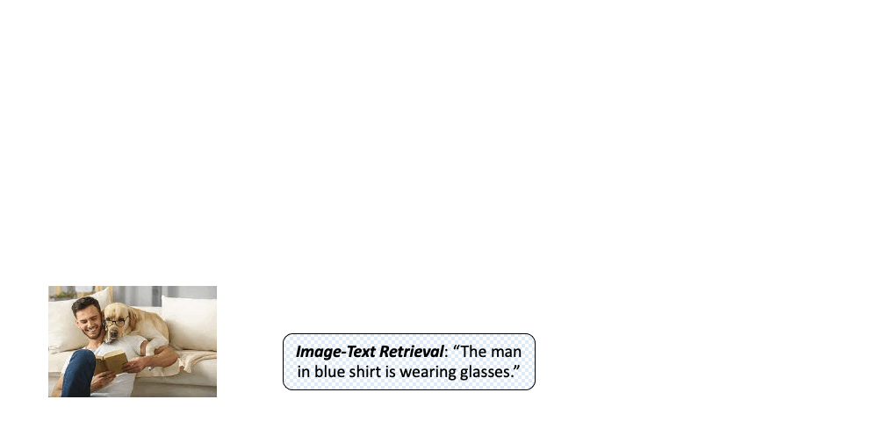
OFA-Variation

Slide 17
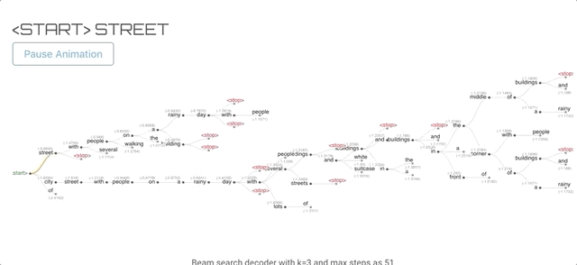
Beam Search
Overview
The beam search algorithm selects multiple tokens for a position in a given sequence based on conditional probability.

Slide 18
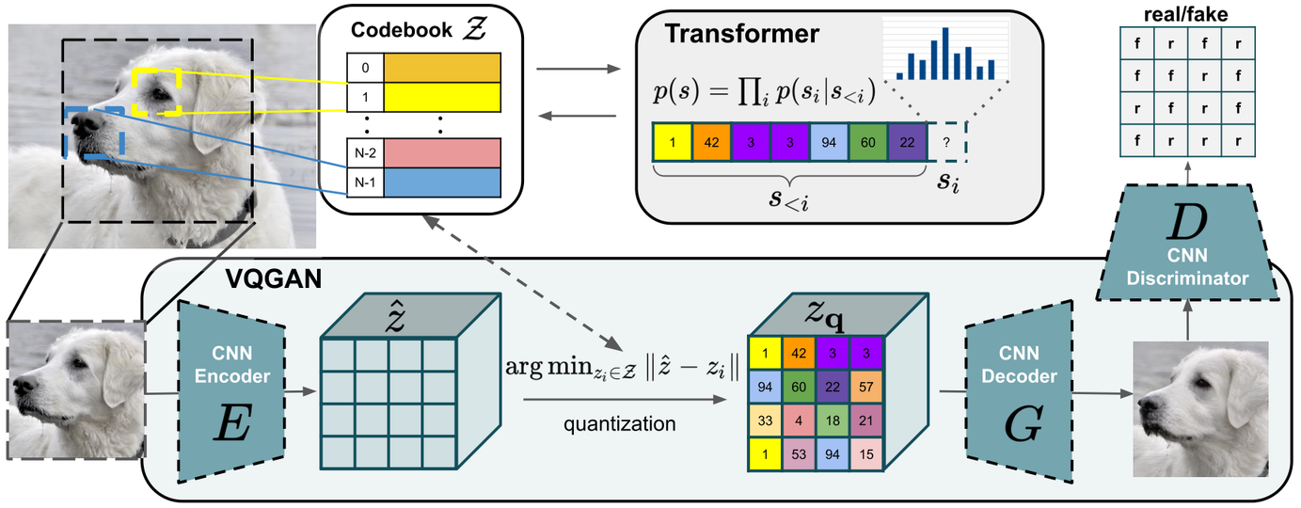
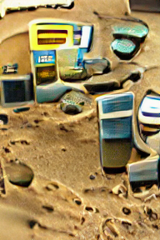

VQGAN+CLIP
Combining the effectiveness of the inductive bias of CNNs with the expressivity of transformers enables them to model and thereby synthesize high-resolution images.

Slide 19
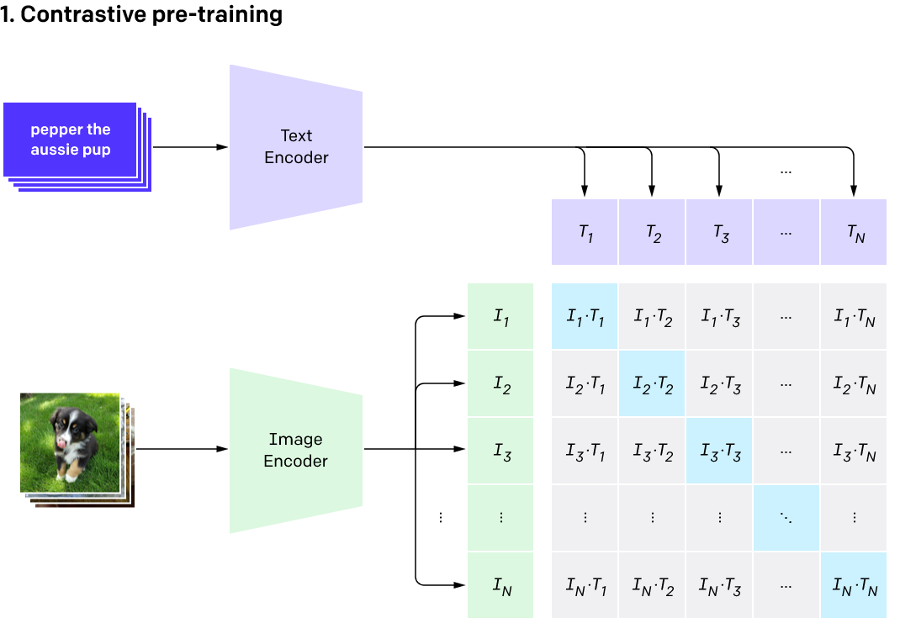
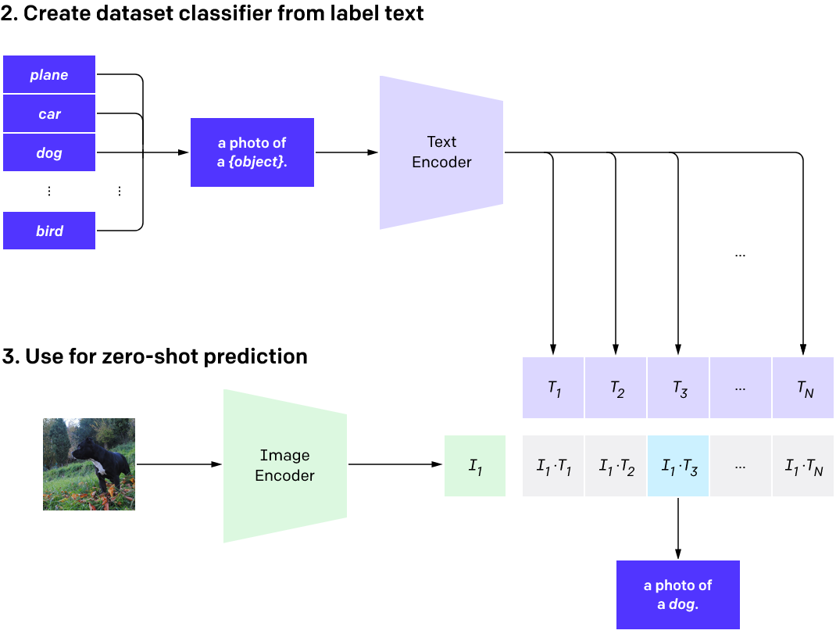
CLIP
CLIP (Contrastive Language–Image Pre-training) is a companion third neural network which finds images based on natural language descriptions, which are what’s initially fed into the VQGAN.
CLIP is not a generative model. CLIP is “just” trained to represent both text and images very well .

Slide 20
Comparing The models
Model | Bleu-1 | Year
Novel Model | 0.49 | 2022
VAE | 0.32 | 2013
Attention based model | 0.56 | 2014
ViT+GPT2 | 0.2636* | 2018
OFA-Variation | 0.435* | 2022
*The Bleu-1 score depends upon the testing data size which is too high for marked results

Slide 21



Future Endeavor
Visual Question Answering
One Shot VGAN
Visual Grounding
Generating high resolution images from scratch without re-training
Locate the most relevant object or region in an image, based on a natural language query
Semantic task that aims to answer questions based on an image.

Slide 22


CONCLUSION
THE BAD
Although contextual understanding is good, the captions produced by the model are very bad due to lack of grammar modelling
THE GOOD
From scratch model understands the context of the scene with at most precision
THE BETTER
The OFA Variation performs exceptionally with very good captioning but the performance of the model with respect to hardware is intensive

Slide 23
References
T. P. Ramsewak, D. Appadoo and Z. Mungloo-Dilmohamud, "EyeSee: Camera to Caption with Attention Mechanism," 2020 IEEE Asia-Pacific Conference on Computer Science and Data Engineering (CSDE), 2020, pp. 1-6, doi: 10.1109/CSDE50874.2020.9411571.
Lakshminarasimhan Srinivasan , Dinesh Sreekanthan , Amutha A.L,"Image Captioning - A Deep Learning Approach", 2019 International Journal of Applied Engineering Research

Slide 24
